Slide 1
Quantum Computing
Quantum Amplitude Estimation
Siddhant Rathi

Slide 2
TABLE OF CONTENTS
01
03
02
04
PROBLEM STATEMENT
IMPLEMENTATION
Problem statement and its mathematical description
Implementation of MLQAE, along with the intermediate steps
ALGORITHMS
CIRCUIT DIAGRAMS
Explanation of MLQAE and IQAE algorithms
Circuit diagrams for MLQAE

Slide 3
PROBLEM STATEMENT

Slide 4
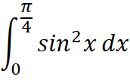
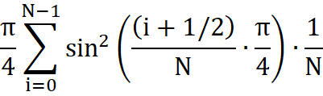
PROBLEM STATEMENT
To calculate the integral
approximately, using Riemann sums with a finite number of subintervals, and making use of Quantum Amplitude Amplification followed by a Quantum Amplitude Estimation algorithm.
Specifically, calculate the value of the expression
for N = 2, 3, and 10.

Slide 5
ALGORITHMS

Slide 6


ALGORITHMS
Operator Selection
The first step consists of constructing a circuit that will take the state |0⟩_{n}|0⟩ into the state
where f(x) is the integrand function, and n is the number of qubits used in our circuit (barring the least significant qubit).
This transformation encodes the N^{th} (2^{n}) Riemann sum in the amplitude of the least significant qubit’s 1 state.
This state can also be represented as
To determine this amplitude, we use Quantum Amplitude Amplification and Estimation for a better precision.

Slide 7



ALGORITHMS
Quantum Amplitude Amplification
To amplify the amplitude of the desired state, we perform the following series of operations
where ‘A’ denotes the operator we constructed during operator selection, and ‘A⁻¹’ denotes its inverse.
The ‘S₀ ’operator is given as , and ‘S_{X}’ is given as .
We pack all the above operators into a single operator, called ‘Q’. Applying this operator ‘m’ times to our state yields
This helps us to measure even a very small θ quite precisely (where sinθ is the amplitude we are interested in). Further, it also reduces the number of queries quadratically (https://www.desmos.com/calculator/juq1sitct1).

Slide 8
ALGORITHMS
Quantum Amplitude Estimation
Finally, we need to estimate the amplitude of the least significant qubit’s 1 state. We discuss the following three approaches for the same:
• Quantum Phase Estimation – This is the usual approach, which consists of using the state obtained after QAA to estimate the phase (2m + 1)θ , which can then be used to calculated θ and thereby sinθ, the amplitude which we intend to determine. (not implemented)
• Maximum Likelihood QAE – It involves using n quantum circuits for QAA, with the n^{th} circuit featuring an amplification by the operator Q. The probability of obtaining 1 as the least significant qubit is calculated for each circuit, which is then input into a maximum likelihood calculation to estimate the most likely θ.
• Iterative QAE – Starting with an upper bound and a lower bound for θ as π/2 and 0 respectively, we iteratively update our bounds by running the circuit multiple times. (not implemented)

Slide 9
IMPLEMENTATION

Slide 10
IMPLEMENTATION
MLQAE
First, we use the gates provided in Qiskit to construct the A, S_{x}, S₀, and A⁻¹ operators, followed by the Q operator. Now, we create circuits with QAA using the A operator, and then estimate the amplitude by the application of the Q operator 2^{n-1} times for the n^{th} circuit.
The hit information is generated by running the simulation (where only the least significant qubit is measured), and the number of ‘1’ hits is recorded.
After obtaining the hit information, we move on to post-processing. Likelihood functions are generated for each of the circuits, and their product is calculated for each theta in a given range. Finally, the theta which yields the highest product is selected as the required phase, and the integral is calculated from it (this approach for MLE is expensive, and can be replaced by more efficient approaches).

Slide 11
CIRCUIT DIAGRAMS

Slide 12
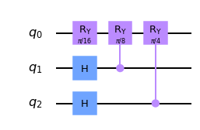
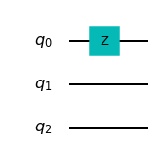
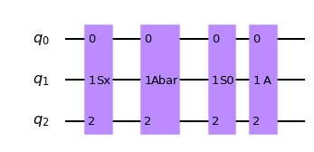
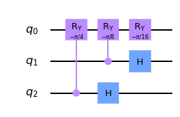
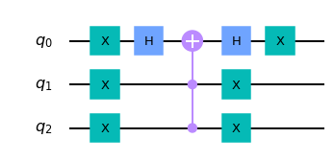
CIRCUIT DIAGRAMS
Circuits for the basic components used to build the subsequent circuits
A
S_{x}
Q = AS₀A⁻¹S_{x}
A⁻¹
S₀

Slide 13
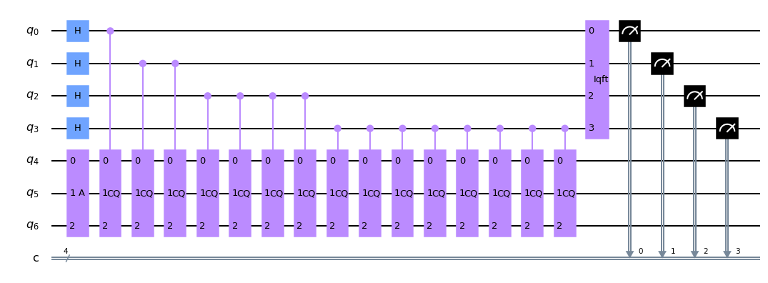
CIRCUIT DIAGRAMS
Circuit for canonical QAE (which uses QPE) with 4 ancilla qubits. While the circuit seems correct, the results did not agree with our predictions. A possible source of error might be in the post-processing.

Slide 14
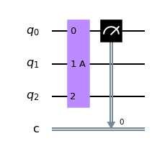
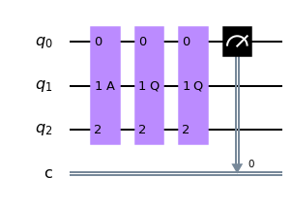
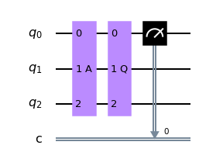
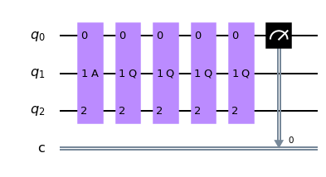
CIRCUIT DIAGRAMS
MLQAE using 4 circuits, with EIS. The maximum absolute error in 20 runs was found to be 0.0029
Using 10 circuits, the maximum absolute error was reduced to 0.00195

Slide 15
REFERENCES
• 2008.02102.pdf (arxiv.org)
• [1904.10246] Amplitude estimation without phase estimation (arxiv.org)
• [1912.05559] Iterative Quantum Amplitude Estimation (arxiv.org)
• Lab 4. Iterative Quantum Phase Estimation (qiskit.org)

Slide 16
THANKS

